Slide 1
MINI PROJECT PRESENTATION
PRESENTED By --->
Name :- Danish Khan
Roll no :- 1814310071
Class :- CSE – 2
PRESENTED To --->
Ravi Sir
Lecturer of CSE Department
IMS ENGINEERING COLLEGE

Slide 2
PRESENTATION FLOW
CERTIFICATION
PROBLEMS
INTRODUCTION
WORKING DIAGRAM
LANGUAGE USED
FEATURES
WORKING

Slide 3
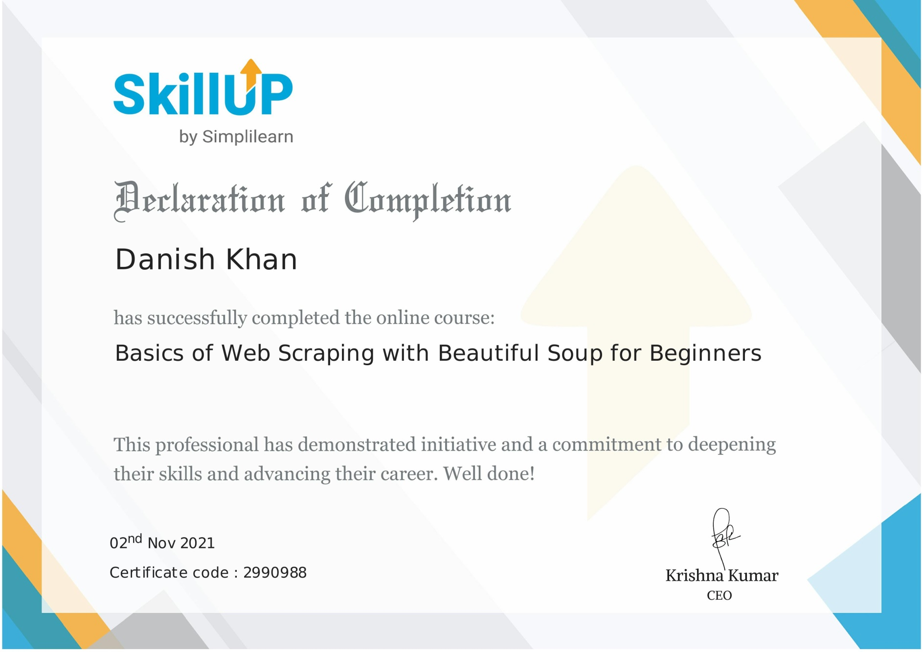
CERTIFICATION

Slide 4
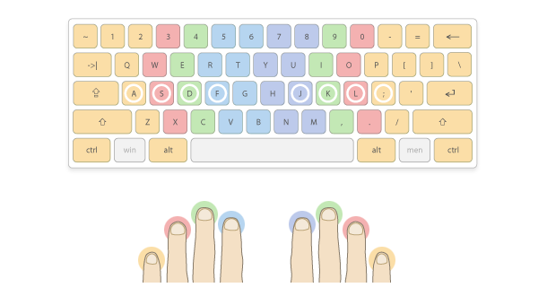
PROBLEM
Data is very important nowadays so people are collecting data just by copying data from web pages and pasting it to the file which is very hectic kind of work because what happens if the data is too big than in this case we will waste our lot of time to copy data from the web pages and then paste it into the file, so there is need of an agent ( Program ) which will do our work in a fraction of second and thus here WEB SCRAPPING program comes into the picture.

Slide 5
INTRODUCTION
The idea behind the project is to make scrapping of web page easy and fast so that people who waste a lot of the time in scrapping the data line by line word by word would be able to do it in a fraction of the second just by typing two to three words as input to the program and rest of the thing will be done by the program.

Slide 6
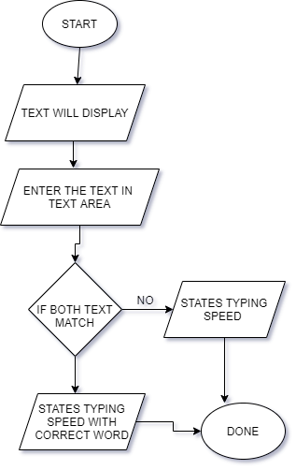
Working Diagram

Slide 7
Languages USED
Python
Python is an interpreted high-level general-purpose programming language. Its design philosophy emphasizes code readability with its use of significant indentation. Its language constructs as well as its object-oriented approach aim to help programmers write clear, logical code for small and large-scale projects

Slide 8
MODULE USED
BEAUTIFULSOUP
REQUESTS
MATH
FLASK
XLSXWRITER

Slide 9
BeautifulSoup
Beautiful Soup is a Python package for parsing HTML and XML documents. It creates a parse tree for parsed pages that can be used to extract data from HTML, which is useful for web scraping.

Slide 10
FLASK
Flask is a micro web framework written in Python. It is classified as a microframework because it does not require particular tools or libraries. It has no database abstraction layer, form validation, or any other components where pre-existing third-party libraries provide common functions.

Slide 11
REQUESTS
Requests is a HTTP library for the Python programming language. The goal of the project is to make HTTP requests simpler and more human-friendly. The current version is 2.26.0. Requests is released under the Apache License 2.0. Requests is one of the most popular Python libraries that is not included with Python.

Slide 12
MATH
The Python Math Library provides us access to some common math functions and constants in Python, which we can use throughout our code for more complex mathematical computations. The library is a built-in Python module, therefore you don't have to do any installation to use it.

Slide 13
XLSXWRITER
XlsxWriter is a Python module for writing files in the XLSX file format. It can be used to write text, numbers, and formulas to multiple worksheets. Also, it supports features such as formatting, images, charts, page setup, auto filters, conditional formatting and many others.

Slide 14
Features
It will collect all the names of doctors who have a particular speciality district wise.
It will display information in the web page and will also create a Excel file and store all the information in the Excel file.
It will take just two input to perform the task.
It will take just 2 minute to fetch data from more than 120 pages.

Slide 15
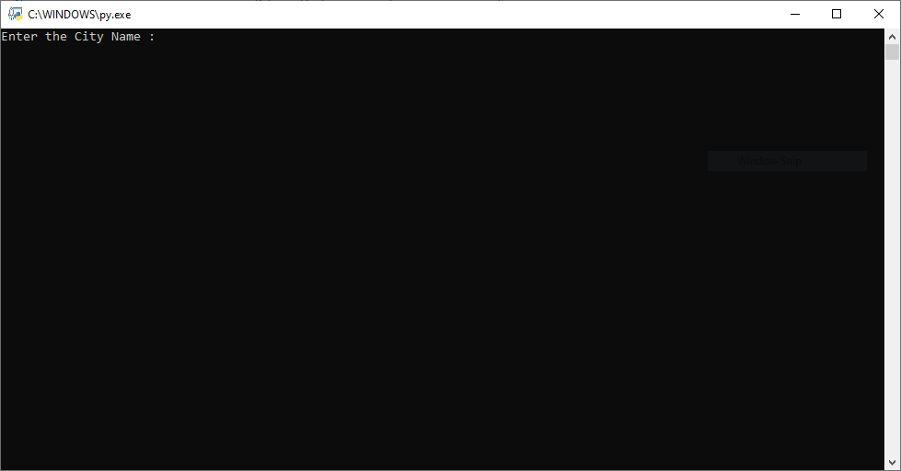
Step 1 :- Execute web scrapping Program and Enter name of the city
WORKING

Slide 16
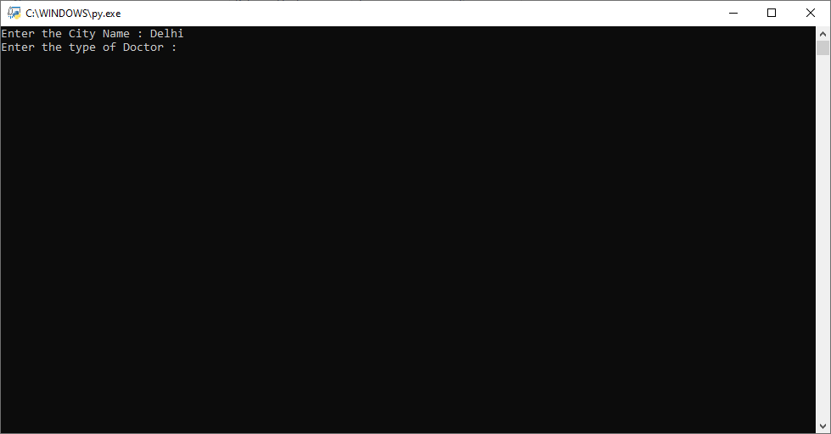
Step 2 :- Enter the Type of Doctor ( Specialty )
WORKING

Slide 17
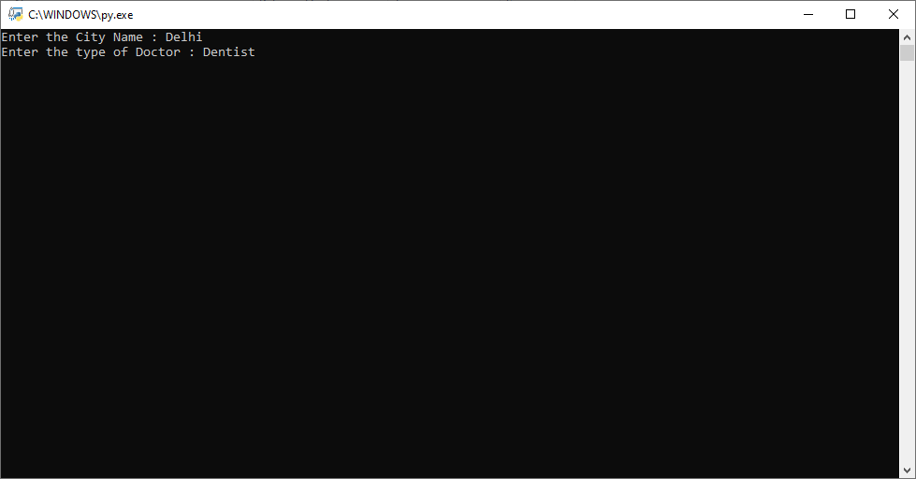
Step 3 :- Press enter button and wait 1 to 2 minute
WORKING

Slide 18
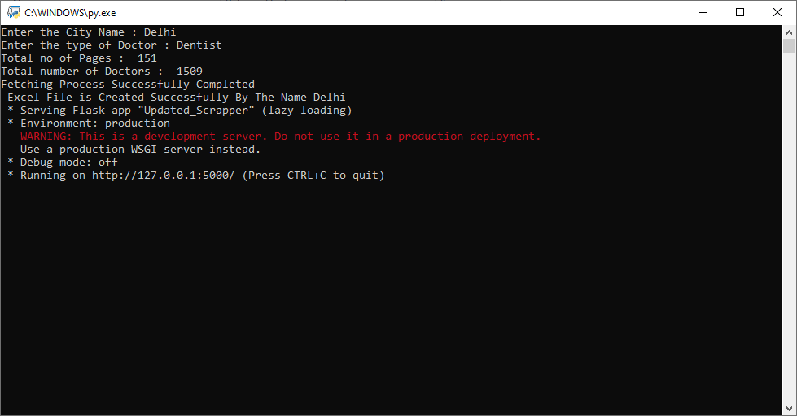
Step 4 :- Data Fetching Process successfully completed
WORKING

Slide 19
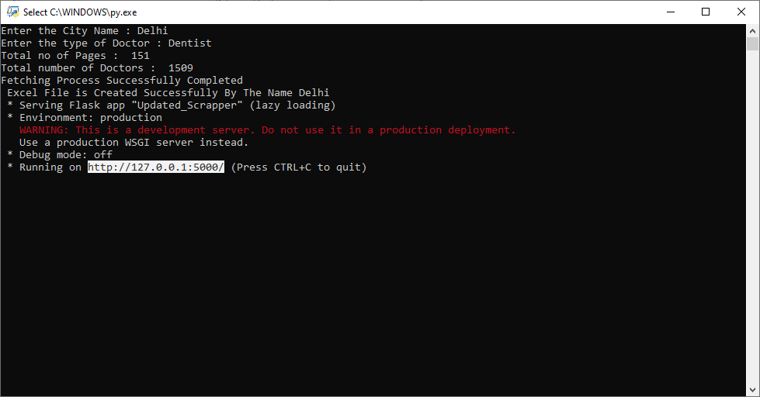
Step 5 :- Copy the HTTP Link and Paste it into the Browser
WORKING

Slide 20
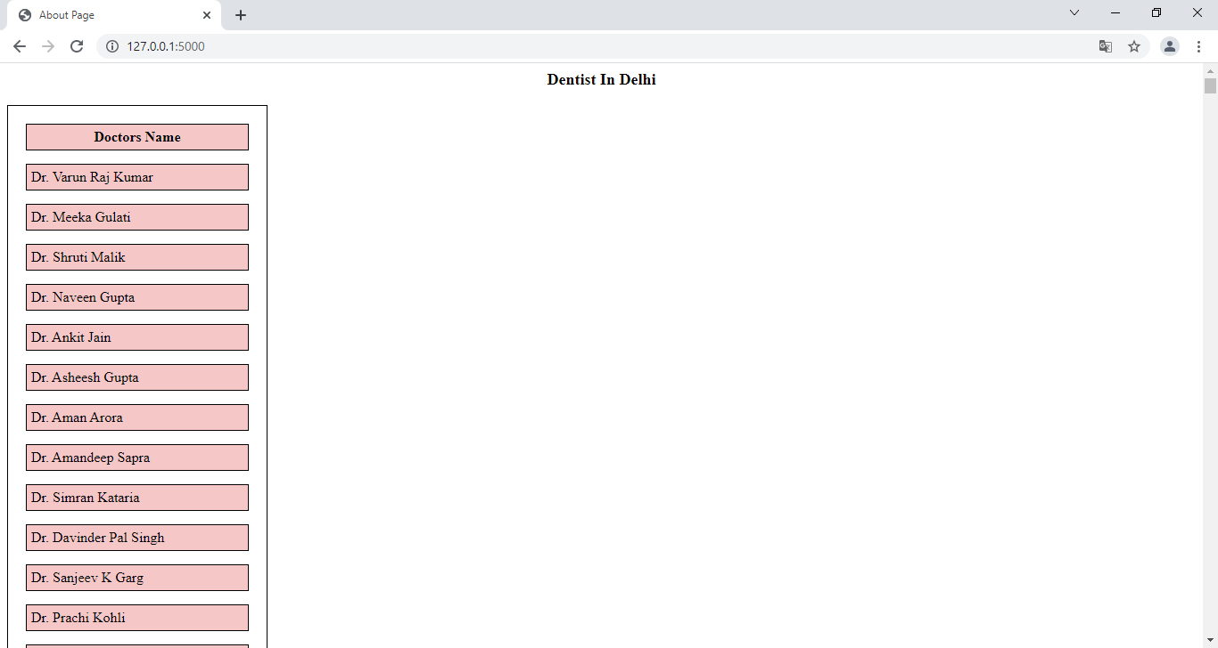
Step 6 :- All the Fetch data is visible in the browser
WORKING

Slide 21
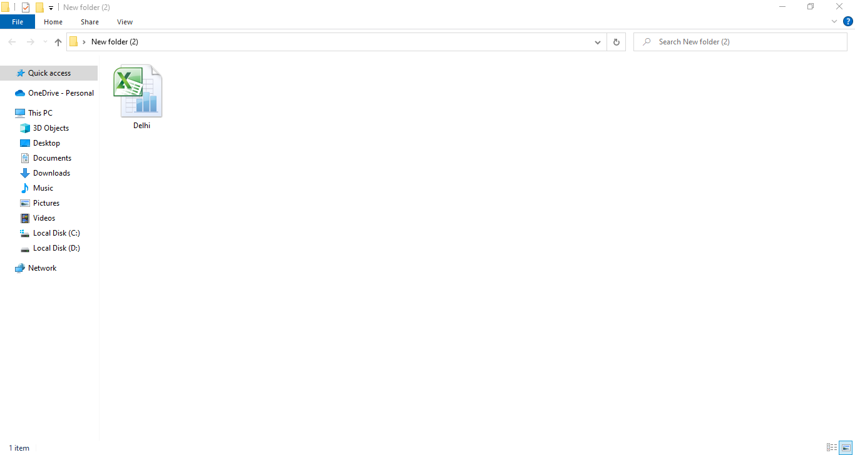
Step 7 :- Excel File will get create by the name of city
WORKING

Slide 22
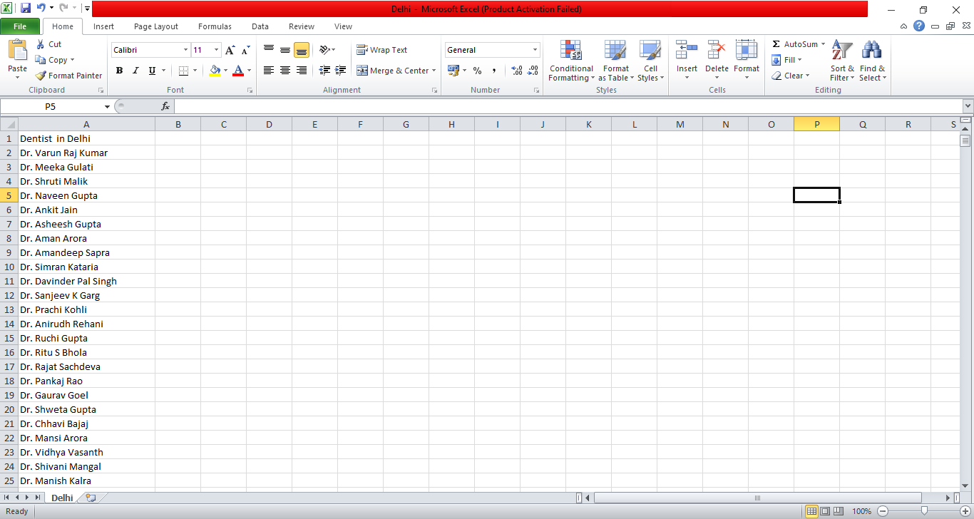
Step 8 :- Excel File contains all the list of Doctors
WORKING

Slide 23
THANK YOU

